Slide 1

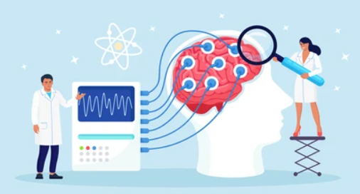
Applying graph theory measures for analyzing networks in brain recordings
Capstone Project Phase 1
Students:
Koral Pnina Biton
Topaz Eldori
Supervisor:
Dr. Anat Dahan
Project Code:
24-1-R-6

Slide 2
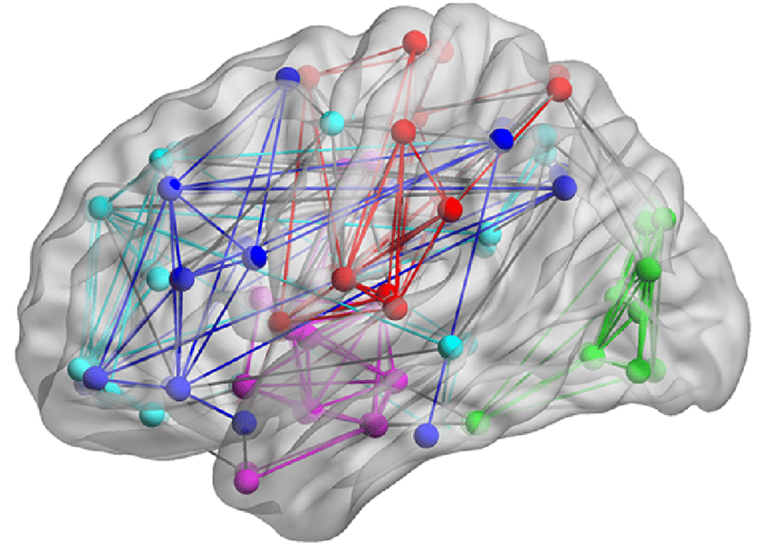
INTRODUCTION
EEG measuring brain electrical signals, aids in diagnosing ADHD by revealing abnormal patterns.
Integrating EEG with graph theory allows for analyzing brain networks, where nodes represent brain regions and edges denote connections.
Our goal is to provide comprehensive information on ADHD detection, by EEG brain recording techniques, the relationship between graph theory and brain networks, and methods for community detection in network analysis.

Slide 3
Background
ADHD Diagnosis
EEG Brain Recording
Graph Theory and Brain Recordings
Community Detection

Slide 4

ADHD Diagnosis
Attention deficit hyperactivity disorder (ADHD) is one of the most common disorders, especially among children.
The disorder is characterized by symptoms such as hyperactivity, difficulty paying attention, and impulsive behavior.
The symptoms can impact academic performance, social interactions, and daily activities. With an earlier diagnosis of ADHD, there is reduced impairment in functioning.

Slide 5
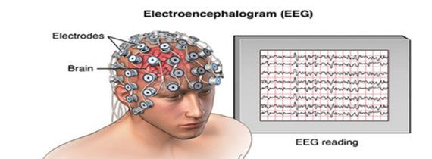
EEG Brain Recording
EEG is a diagnostic technique used to measure brain activity by recording electrical signals generated by neurons.
During an EEG procedure, small flat metal discs called electrodes are placed on the scalp to detect and record these electrical signals.
The EEG recording displays a line for each electrode, these lines can be analyzed to understand brain activity.

Slide 6
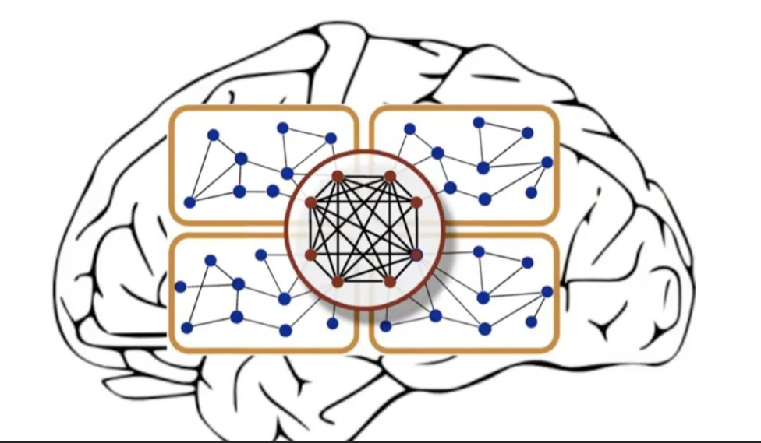
Graph Theory and Brain Recordings
EEG testing is important for understanding brain activity because our brain functions like a network, with different parts working together during tasks and neurological states.
By using graph theory, we can analyze EEG data and gain important insights into the interactions between different brain regions during cognitive tasks.
In the graphs nodes represent the electrode locations, while edges indicate functional connectivity between these locations.

Slide 7
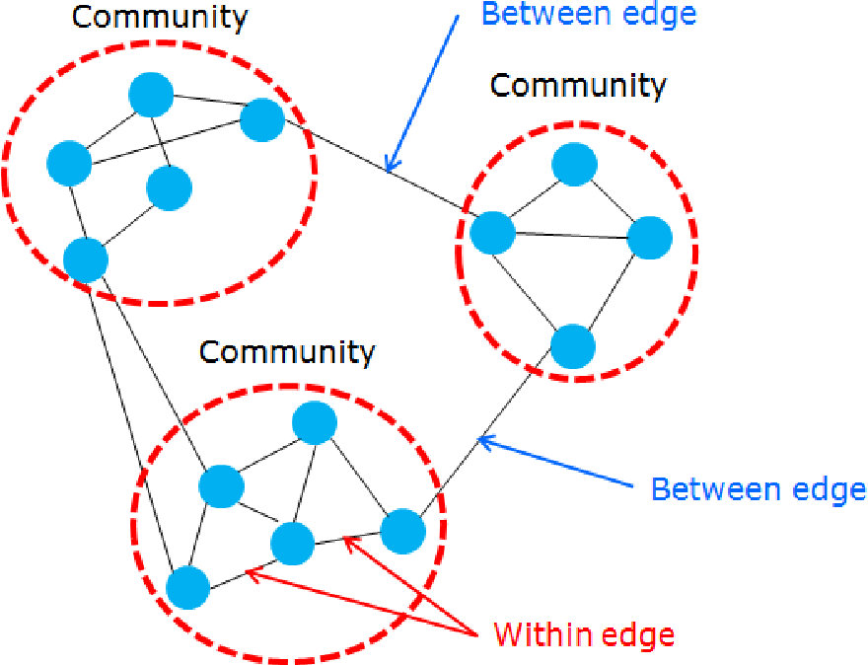
Community Detection
Community detection refers to identifying groups or sub-networks within a larger graph. This concept is relevant across various systems, including social, biological, and political contexts.
Through community detection methods, we can algorithmically reveal the structure of networks.
Understanding the structure of communities within brain networks can offer valuable insights into brain function as the brain functions in networks and not is isolated regions.

Slide 8
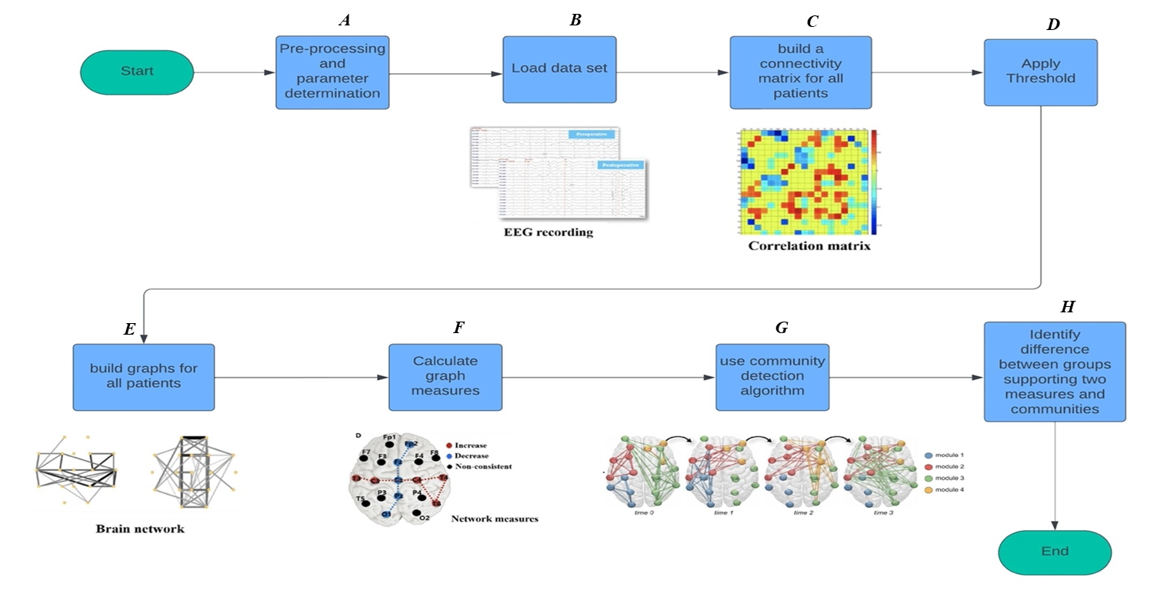
Data Process

Slide 9
Pre-processing and parameter determination
A
Pearson correlation
We chose to utilize Pearson’s correlation coefficient, which is the most widely used technique to determine the correlation (weight) of signals between a pair of nodes.
The Pearson correlation coefficient quantifies the strength and direction of the linear relationship between two variables.

Slide 10
Pre-processing and parameter determination
A
Threshold
threshold is using in a graph is to eliminate the weak connections in the graph.
The selection of the threshold should be done with deep thought in order to reach the relevant conclusions of the study.
The selection of the threshold will be determined in continue the research of the project when we examine possible thresholds.

Slide 11
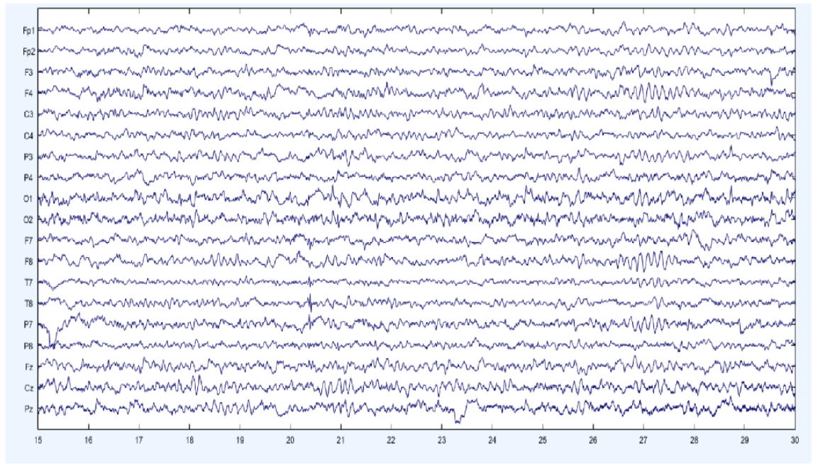

Load data set
B
Our dataset consists of 61 children with ADHD and 60 typically developing children aged between 7 and 12, encompassing both genders. The EEG recordings were conducted utilizing 19 channels at a frequency of 128 Hz.
In the task, a set of pictures of cartoon characters was shown to the children and they were asked to count the characters.
The number of characters in each image was randomly selected between 5 and 16.

Slide 12
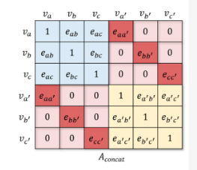
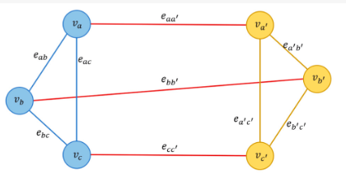
Build connectivity matrix for all patients
C
After loading the data set and before creating the graph we create a connectivity matrix of size NXN where n indicates the number of electrodes.
The diagonal elements represent the correlation of each electrode with itself, this correlation is equal to 1. The other elements represent the correlation between pairs of electrodes. this correlation calculates by Pearson correlation.

Slide 13
Build graphs for all patients
E
After selecting the threshold and calculating it, we will accordingly build a graph for each patient whose nodes in the graph represent the locations of the electrodes, while the edges indicate functional connectivity between these locations.
After constructing the graph, we can gain important insights into the interactions between different brain regions during cognitive tasks for each patient.

Slide 14
Calculate graph measures
F
In graph theory, both local and global measures are used for analysis. Local measures focus on individual nodes or edges, while global measures describe the properties of the entire network.
We chose to use the following measures to reach appropriate insights for the study:
Global Efficiency (Global) ,Local Clustering Coefficient (Local) ,Average Degree (Global)

Slide 15
Calculate graph measures
F
Global Efficiency (Global): This measure how efficiently information can be transmitted across the entire network. It's the average of the shortest path lengths between all pairs of nodes.
Local Clustering Coefficient (Local): The local clustering coefficient of a node measures how close its neighbors are to being a complete graph.
Average Degree (Global): This is the average number of connections each node has in the network.

Slide 16
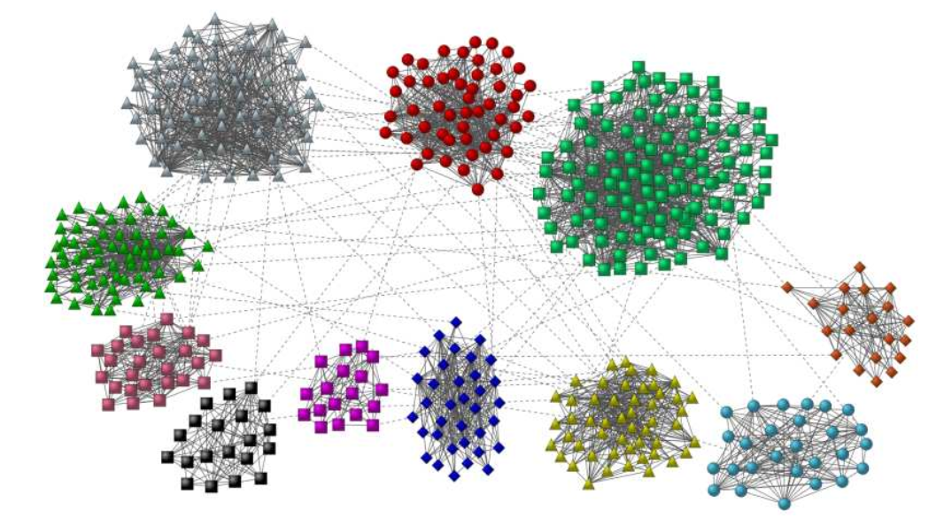
Use community detection algorithm
G
Fast Greedy
The fast greedy algorithm presents an efficient method for identifying communities within networks by maximizing modularity.
Initially, it constructs a subnetwork consisting solely of connections among densely linked nodes. Subsequently, the algorithm iteratively selects random links that enhance the subnetwork's modularity and incorporates them.
This iterative procedure continues as long as modularity enhancements are observed. Ultimately, communities are delineated based on the connected components present within the subnetwork

Slide 17

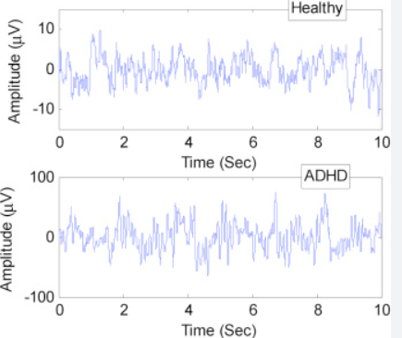
Identifying differences between groups
H
We are interested in understanding the differences between the ADHD and control groups. We will do this by calculating the average graph measures for each group and then comparing them.

Slide 18
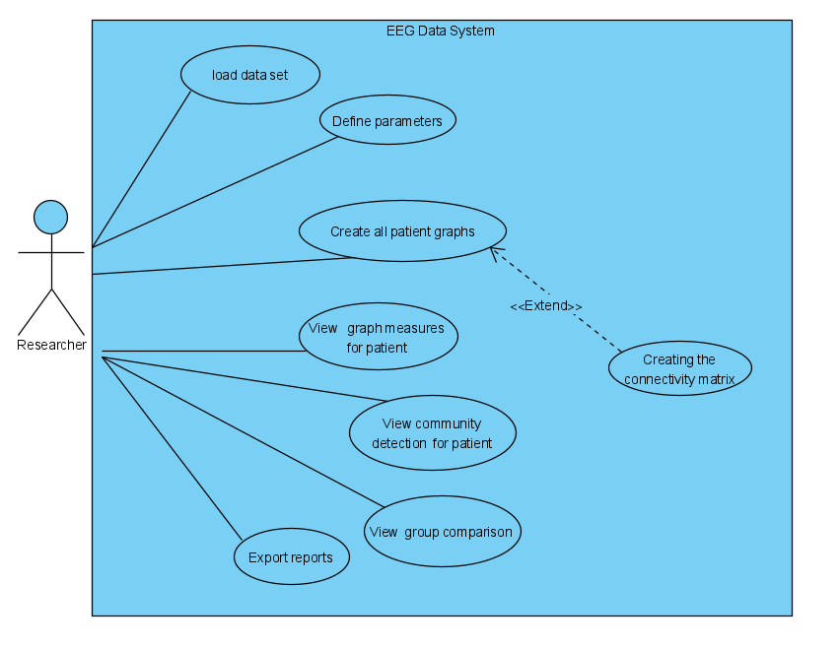
Use Case Diagram

Slide 19
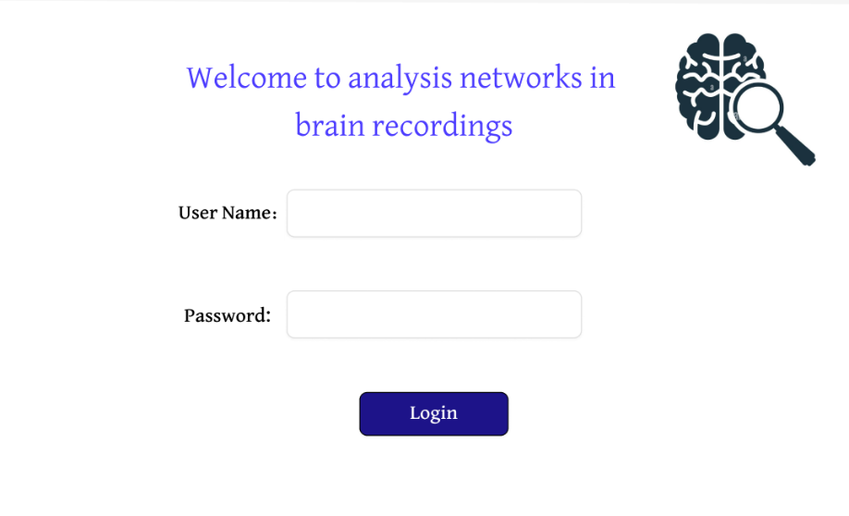
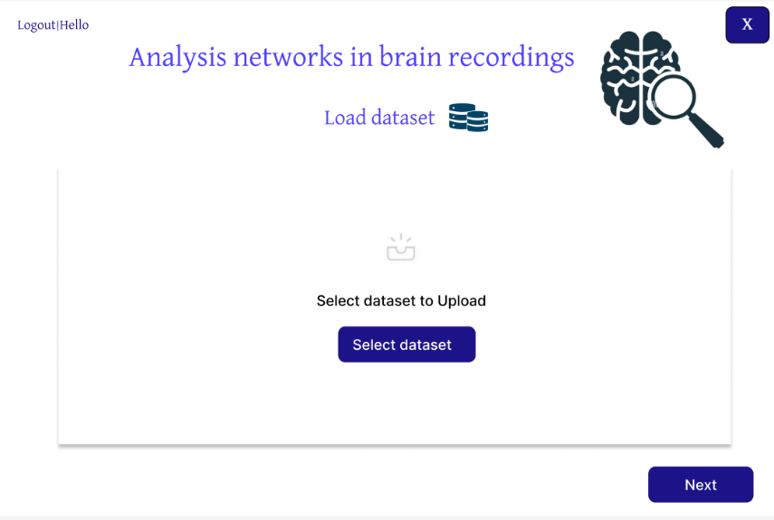
Prototype

Slide 20
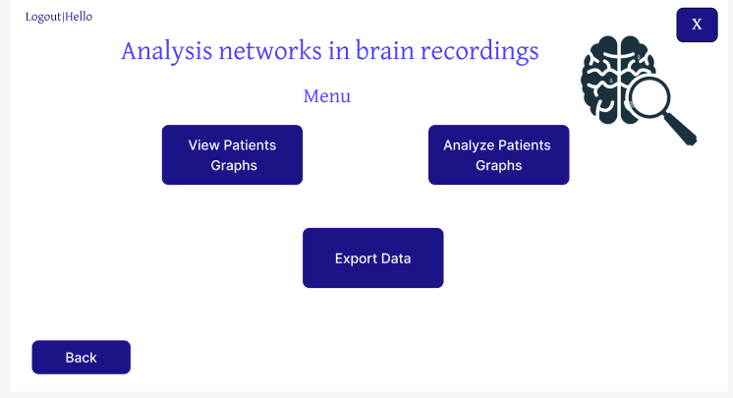
Prototype

Slide 21
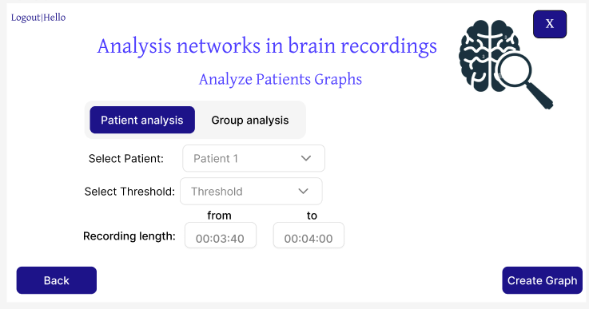
Prototype

Slide 22
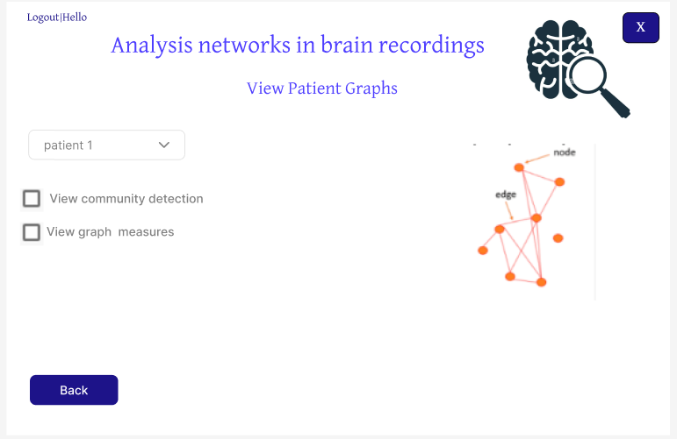
Prototype

Slide 23
Verification plan
Test No. | Test Subject | Expected Result
1 | Insert same signal to connectivity matrix | Because we use Pearson correlation calculation the expected result of the same signal is 1.
2 | Insert different signals to connectivity matrix | Because we use Pearson correlation calculation the expected result of different signals is between 0-1.
3 | Apply threshold | It is observed that the results of the chosen threshold will be the same for articles with the same data set and the same threshold.
4 | Build graph for all patients. | It was observed that the graphs of the patients would be similar to the graphs in the articles with the same data set.
5 | Calculate graph measures | It will be observed that if we take a simple graph and calculate all the measures on it or for a graph whose results we know we will get a correct calculation of the measures.
6 | Using community detection algorithm | We will observe that if we take a graph whose community modules are known and put it into our community detection algorithm, we will expect to get the same modules in the graph.

Slide 24
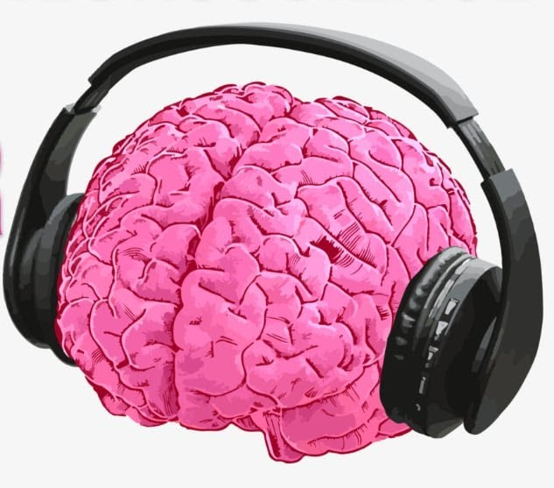
Thanks for Listening

